Slide 1
Towards User-Centric Dsls to Manage IoT Systems
Moussa Amrani, Fabian Gilson, Abdelmounaim Debieche, Vincent Englebert
Modelsward, Monday 20th February 2017, Porto (Portugal)

Slide 2
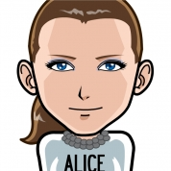
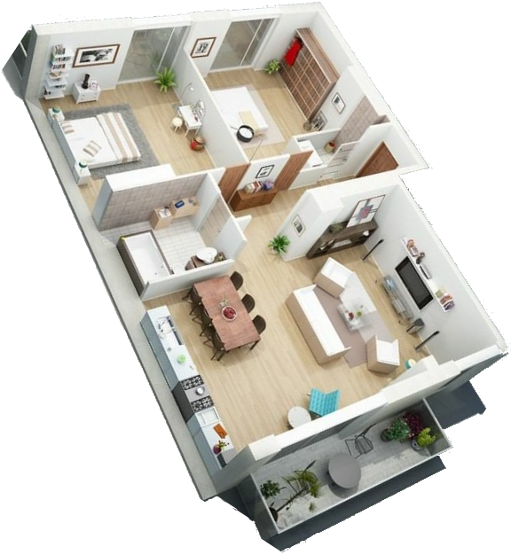
At Alice’s
Active Workwoman Alice:
House Monitoring (temp., light, humidity, etc.)
Security (smoke + carbon dioxide)
Entertainment
Concern: Being able to quickly reconfigure her home’s equipment according to lifestyle

Slide 3

At Bob’s
Elderly with ageing diseases:
Potential falls notified to family
Entertainment
Concern: Feeling safe at home by notifying family of any critical fall

Slide 4
What’s Missing?
Same functionalities, various things/devices
Different device providers with
Different technologies
Different protocols
Different device combinations
Close functionalities realising quite different scenarios
IoT System Interactions guided by end-users, depending on
the year’s period;
the day’s moment;
the inhabitants;
etc.
Contextual Info!

Slide 5
Proposal
User-Centric construction of IoT Systems
Rather than
Constructor-Centric imposed systems

Slide 6
Agenda
IoTDsl & Main Challenges
Conclusion & Future Work

Slide 7
IoTDsl: Put the User in Charge

Slide 8
Main Features
Fully Mde-based
Everything is modelled explicitly (even tiny native expressions)
Currently based on textual syntax for rapid prototyping
Based on metamodelling standard Omg Mof/Ecore
Event-Based Language for specifying interactions
Natural paradigm for embedded systems
Clean separation / interface between system and environment
Clean separation of concerns

Slide 9
Dsls for describing IoT configs
Devices Type Declaration
Which devices in the system?
Which capabilities for each device?
Network Configuration
How devices are connected to each others?
How do they communicate?
Dynamics
How do they interact with each others?
How capabilities are leveraged to realise users’ scenarios

Slide 10
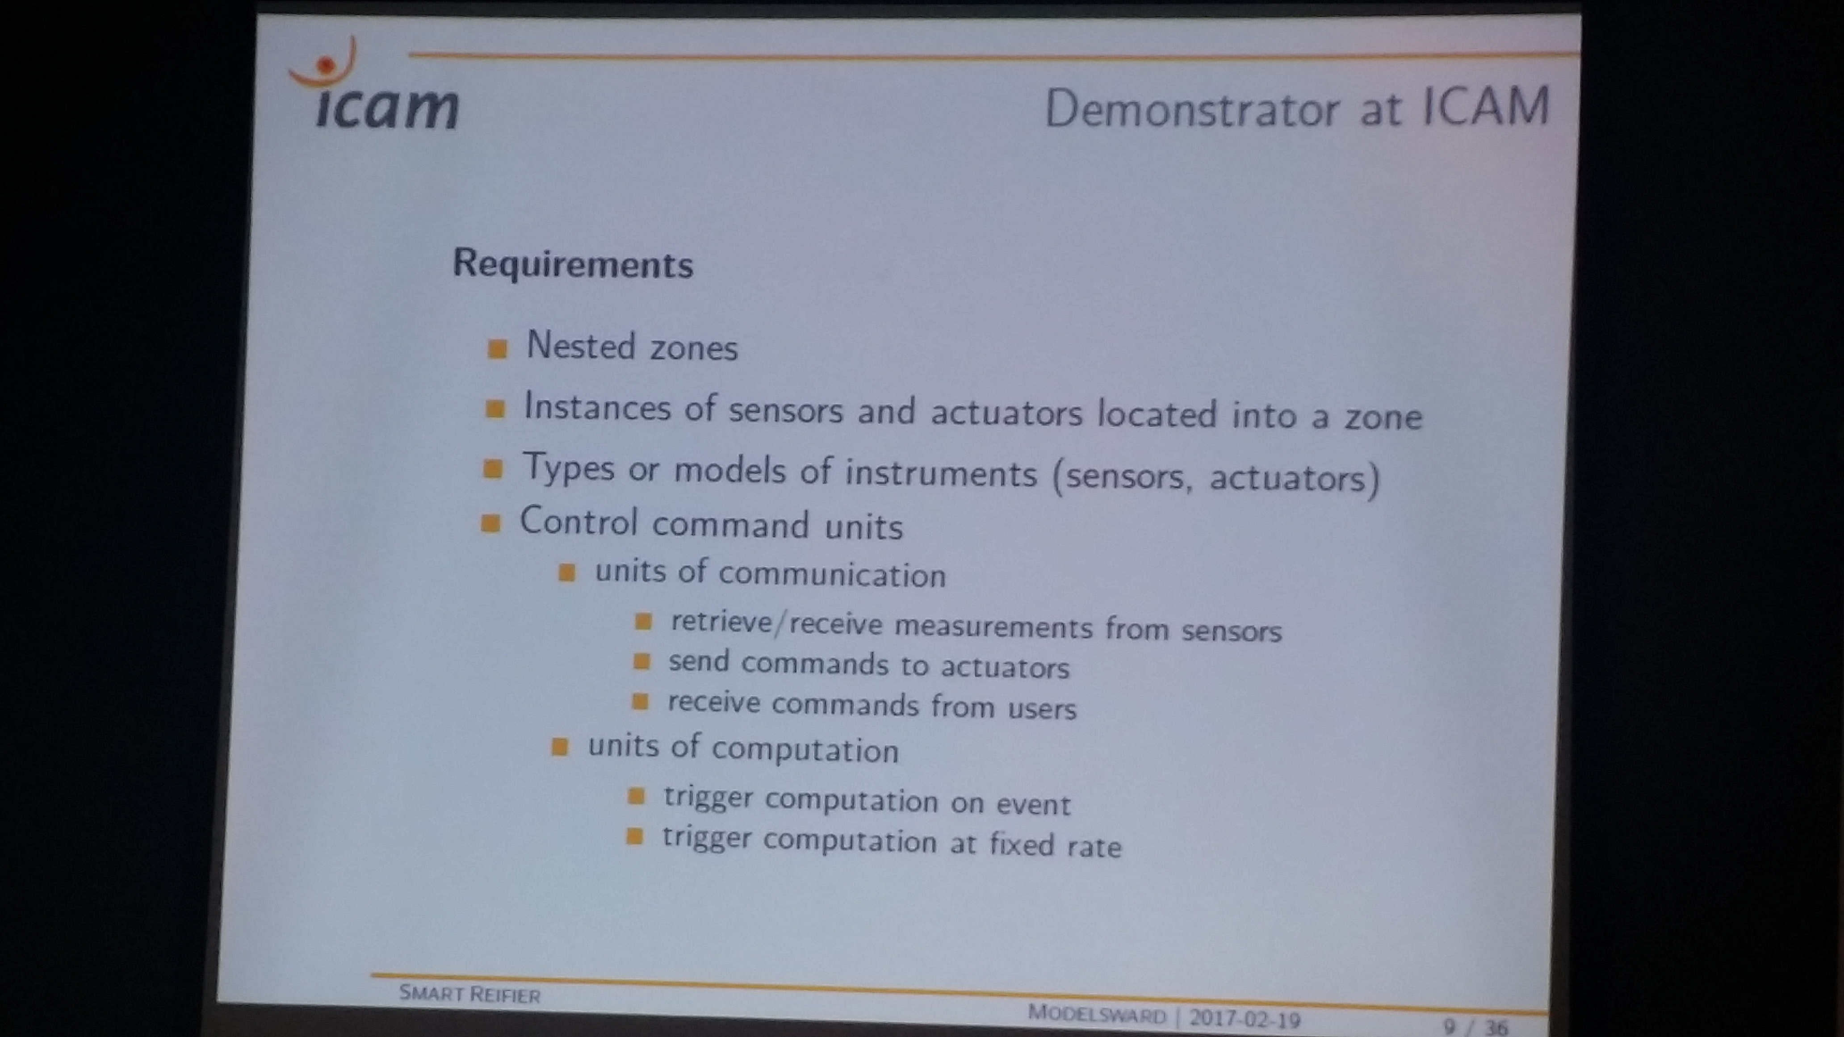
SmartReifier as an illustration

Slide 11
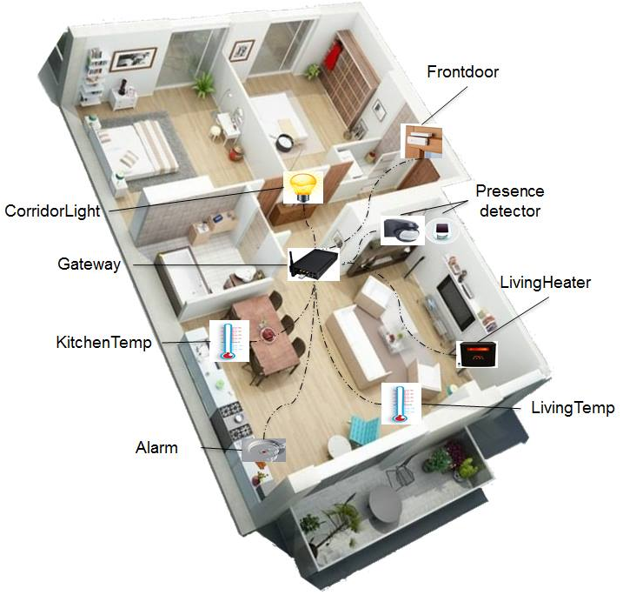
Running Example: Alice’s Home
[WELCOME] When Alice gets home, the lights in the entrance / hallway should switch on
[COSY] When Alice stays in the living room long enough, the room’s temperature should be maintained in comfortable temperatures’ range; whereas when absent, it should not drop below 16
[FIRE] When smoke is detected in the kitchen while the kitchen’s temp exceeds 40 for at least five minutes, notify fire.

Slide 12
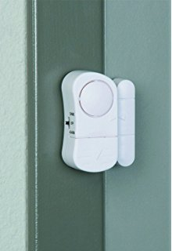
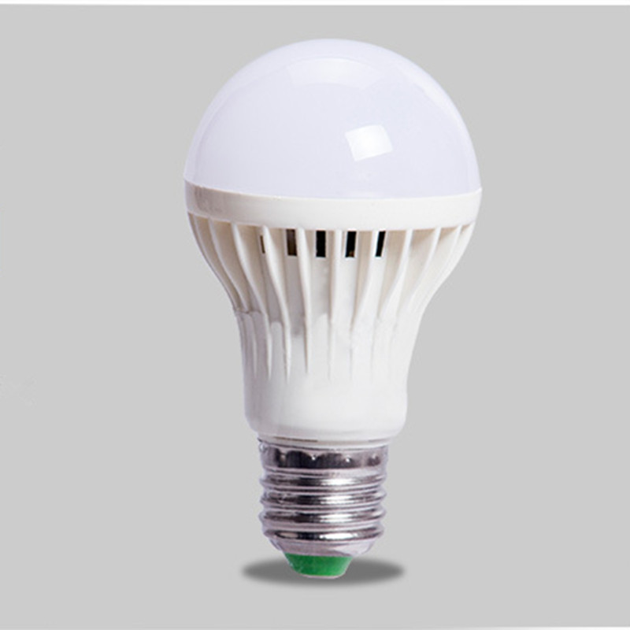
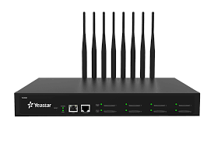
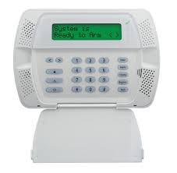
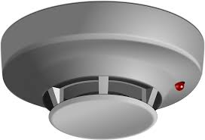
Capture Devices’ Capabilities
device DoorLock {
sensing open()
sensing close()
}
device LightBulb {
actuating on()
actuating off()
actuating blink()
}
device Gateway {}
device SmokeDetector {
sensing smoke()
actuating alarm()
}
device Alarm {
actuating ring()
}

Slide 13
Reflect Network Configuration
Mqtt
living
Mqtt
corridor
Tcp
configuration MyHome {
node gw : Central
node frontdoor : DoorLock
node corridorLight : LightBulb
node livingLight : LightBulb
node corridorDetector: PresenceDetector
node livingDetector : PresenceDetector
...
from frontdoor to gw via MQTT
from corridorLight to gw via MQTT
from livingLight to gw via TCP
...
}
Tcp

Slide 14
Express Users’ Rules
[WELCOME] When Alice gets home, the lights in the entrance / hallway should switch on
rule SwitchLightsWhenEnter:
when (frontdoor.opened() and after corridorDetector.detected()) do {
corridorLight.on() || livingLight.on()
}
[FIRE] When smoke is detected in the kitchen while the kitchen’s temp exceeds 40 for at least five minutes, notify fire.
rule AlarmWhenSmokeAndHighTemp:
when (kitchenTemp.getTemp() > 45 within 5 min from smokeDetector.smoke()) do {
alarm.sound()
}

Slide 15
Challenges (among others)
Capability/Network Discovery in dynamically changing IoT Systems
Once connected, what capabilities does a device expose to the external world?
Lack of uniform and standardised protocol (just like for Usb, BlueTooth, etc.)
Complex Event Processing (Cep)
Expose high-level, abstract capabilities, instead of low-level, technical ones
Complex analysis of data streams to filter and expose only what is scenario-relevant
Bi-directional operation to translate back
Interoperability
Abstract away from how devices are connected:
Data (un-)wrapping/encoding
Transportation
Message Queuing/Management
Data Management
Handle large streams of events
Storage and Post-Processing (also useful for Cep)
Mining capabilities to extract relevant info

Slide 16
Related Work
ThingML [Harrand et al., 2016] & ArduinoML [Mosser et al., 2014]
Similar thing description (based on messages, ports, etc.)
Purpose: program things, instead of using them for users’ scenarios
Midgar [Garcia et al., 2014] and [Salihbegovic et al., 2015]
Visual Interface for controlling interconnected devices
Automatic Generation of « glue » code for interconnection
Specific Application Domains: Smart-Home Patient Monitoring,
Chariot [Pradhan et al., 2015] and Alph [Munnelly and Clarke, 2008]

Slide 17
Conclusions & Future Work

Slide 18
Conclusion
IoTDsl: A prototype Dsl to capture IoT systems at a high-level of representation
Identified challenges to make IoT systems more flexible and usable by end-users

Slide 19
Future Work
Integrate a Cep System
Handle high-level constructs in a secured way
Investigate possibility to decentralise processing
Integrate context
Internal State representation that influence decisions units Examples: « all the time sensor is in alarm mode »; « continue to enforce temperature until reached »
Space Representation modelling (an abstraction of) topological constraints, without delving into topological considerations Examples: Room A is adjacent to Room B and above LR

